Slide 1
Fine Grained Emotion Recognition for Counselling
- Machine Learning and Natural Language Processing

Slide 2
Dataset
The dataset Dreaddit is a new text corpus of lengthy multi-domain social media data for the identification of various emotions. The dataset consists of 190K posts from five different categories of Reddit communities with additionally labelled 3.5K total segments taken from 3K posts using Amazon Mechanical Turk.
The dataset includes ten subreddits in the five domains of Abuse, anxiety, financial, PTSD ,social .
This corpus will facilitate the development of models for this problem, which has diverse applications in areas such as diagnosing physical and mental illness, gauging public mood and worries in politics and economics, and tracking the effects of disasters.
The average length of a post in the dataset is 420 tokens, much longer than most microblog data (e.g., Twitter’s character limit as of this writing is 280 characters).

Slide 3
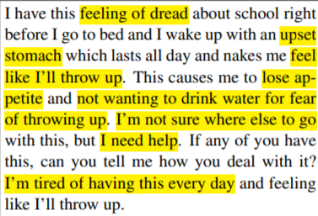
Example from Dataset

Slide 4
Categories in the Dataset for Analysis
In addition to the words of the posts (both as bag-of-n-grams and distributed word embeddings), the dataset includes features in three categories:
The three categories are :
Lexical features: Average, maximum, and minimum scores for pleasantness, activation, and imagery from the Dictionary of Affect in Language (DAL) (Whissel, 2009); the full suite of 93 LIWC features; and sentiment calculated using the Pattern sentiment library (Smedt and Daelemans, 2012).
Syntactic features: Part-of-speech unigrams and bigrams, the Flesch-Kincaid Grade Level, and the Automated Readability Index.
Social media features: The UTC timestamp of the post; the ratio of upvotes to downvotes on the post, where an upvote roughly corresponds to a reaction of “like” and a downvote to “dislike” (upvote ratio); the net score of the post (karma) (calculated by Reddit, η _{upvotes} − η _{downvotes}) ; and the total number of comments in the entire thread under the post

Slide 5
About the Dataset
The dataset consists of word categories from the Linguistic Inquiry and Word Count (LIWC), a lexicon-based tool that gives scores for psychologically relevant categories such as sadness or cognitive processes, as a proxy for topic prevalence and expression variety
Some examples of various categories of features used are:
Lexical features: lex_liwc_Authentic, lex_liwc_Tone , lex_dal_max_pleasantness , lex_dal_max_activation , lex_dal_max_imagery, lex_dal_min_pleasantness, lex_dal_avg_pleasantness
Syntactic features: syntax_ari
Social media features: social_upvote_ratio, social_num_comments, syntax_fk_grade sentiment , social_timestamp , social_karma

Slide 6
Training and Test Set
This results in a total of 2,838 train data points and 715 test data points which can be used for training and testing the model.

